Slide 1
Semantic web and linked data
Group 01
Antonio Hermoso de Mingo
Jose Daniel Jimenez Delgado
Pablo Santamaría Cirac
Gonzalo Santamaría de Paredes
Alejandro Vizcaino Alemany

Slide 2
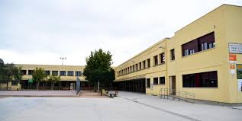
Introduction
Dataset of Public Schools in Madrid
Composed by 240 schools and a lot of attributes

Slide 3
Assignment 1
Public Schools Madrid satisfy the requirements:
Selected smart city domains
Available as a CSV file
Dataset has an open license
Can be easily link with generic real-world entities (as District or Borough)

Slide 4
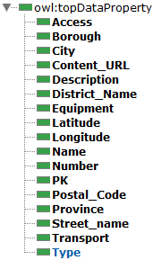
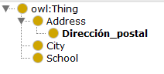
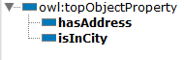
Assignment 2
Propose Ontology
Naming strategy:
http://handsOn.org/Group1
http://handsOn.org/Group1#Resource

Slide 5
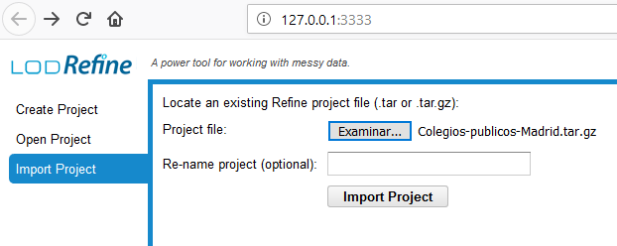
Assignment 3
1) Import Project
2) Fix data
Check for wrong characters
Check for misspelling mistakes

Slide 6
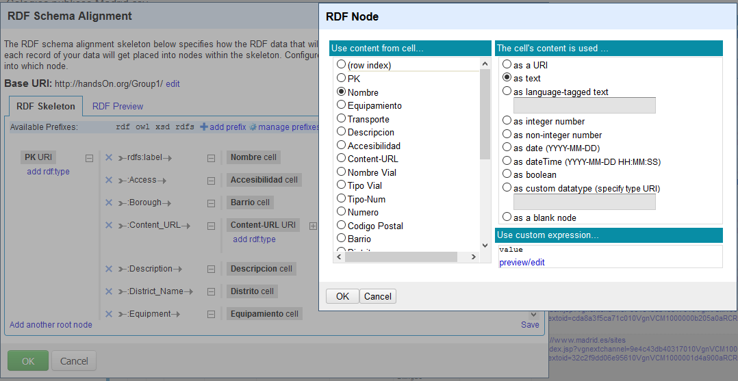
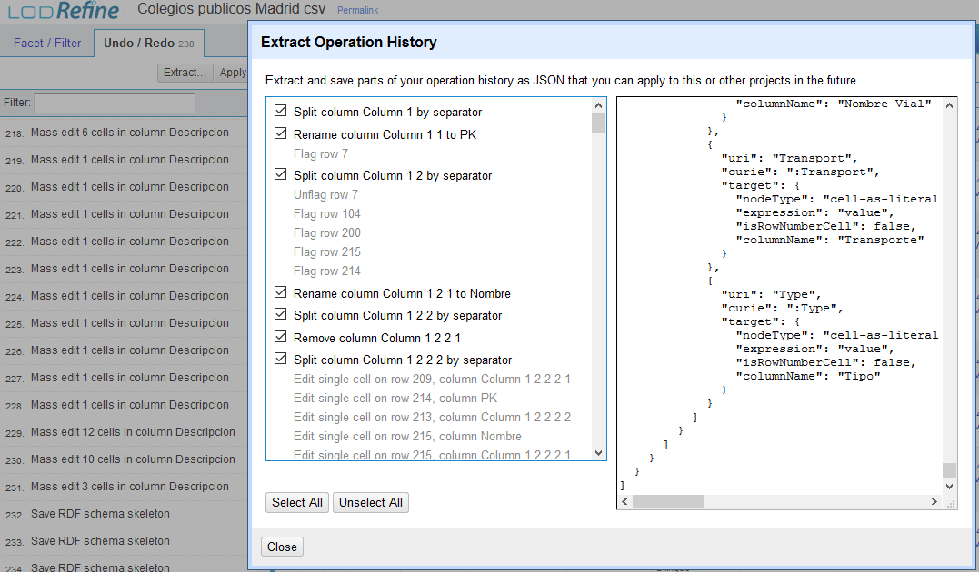
3) Create RDF
RDF -> Edit RDF skeleton…
Use ontology
4) Export JSON
Undo/Redo -> Extract…

Slide 7
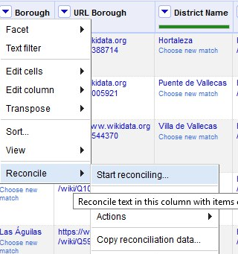
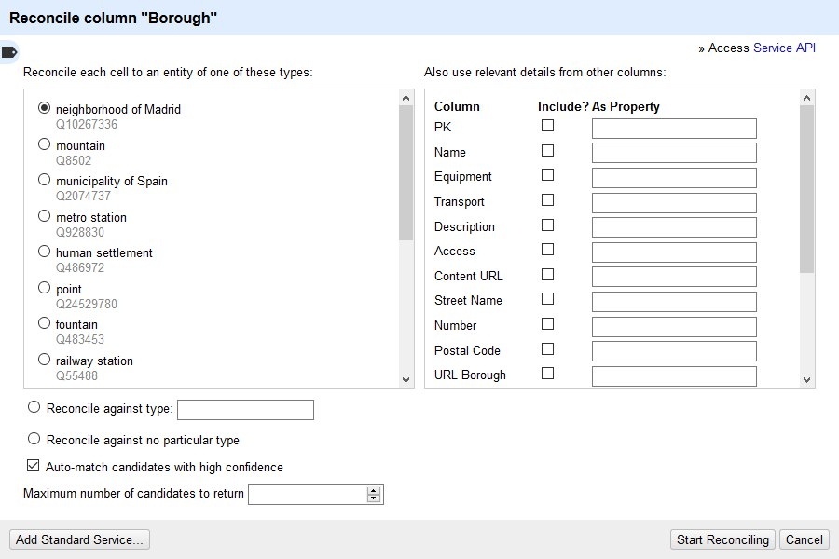
Assignment 4
Reconcile
Start Reconciling
Wikidata (EN)
Select an option
Neigborhood of Madrid
Search for match / Choose new match

Slide 8
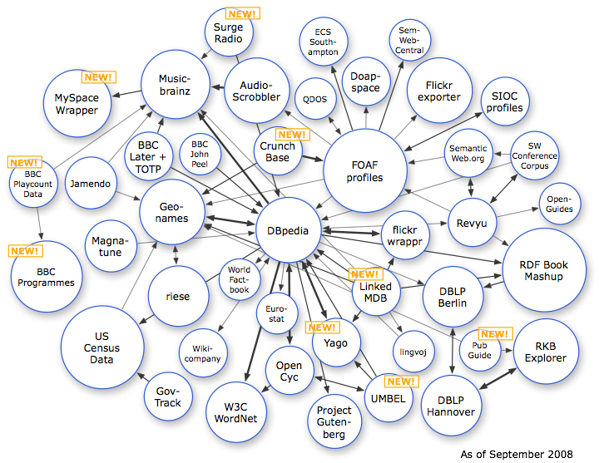
Assignment 5
Ontology Search
Reuse existing models: Urbanismo-infraestructuras/dirección
Select clases/properties
Update Ontology

Slide 9

Conclussions
Wide Project
Real life applications
Usefull for our careers

Slide 10
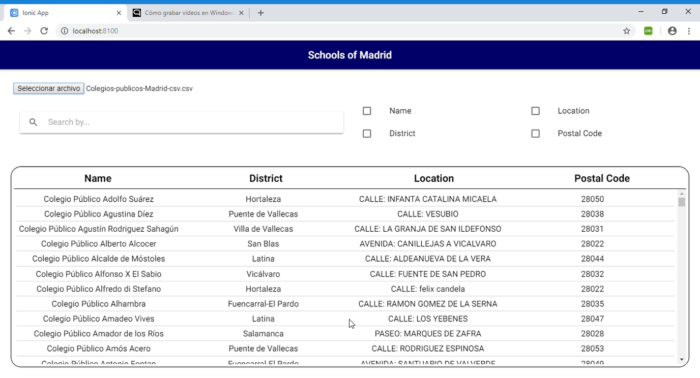
App

